Slide 1

Developer Productivity Tips
Jay Smith

Slide 2
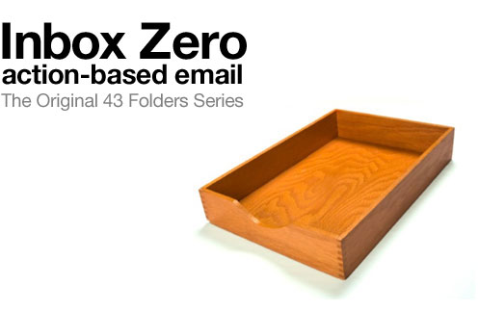
Notes:
From Marilyn Man Google Talk – YouTube
From David Allen’s book Getting Things Done!
“Advanced Common Sense” – David Allen
Email is a medium
You shouldn’t be living in your inbox, that is not where the interesting things are happening.
Process to Zero – Every time you check you email you process to zero. Checking email is not processing.
Don’t let email stack up on you.
Action Based – This is all about converting things in your inbox into actions.
Some people are good at checking email but not so good a turning them into actions
Deleting an email is an action

Slide 3
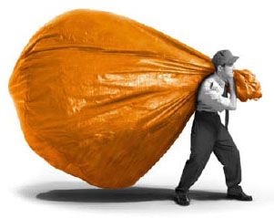
Processing vs. Checking
Notes:
Processing email is where you will find the biggest impact on your day to day
Checking is not responding, or turning it into an action. Checking brings with it a certain amount of responsibility.
Exploding cats story.
Every email does not have to have a respond. If you have 200 email in your inbox you don’t have to respond to 200 emails you have to process 200 emails.
At the end of the day you are going to look at every piece of email and answer “What am I going to do with it?” Where does it go. What actions do I have to take as a result of this email.

Slide 4





Delete (Archive)
Delegate
Respond
Defer
Do
Notes:
Reduce it down to 5 things I can do with that email. The number of things may differ for you.
Delete – Much of the email you receive should just be delete. It requires no action from you.
Not: keep it till I weep, sitting in front of the inbox scrolling
Delegate – Is this something someone else should be working on.

Slide 5
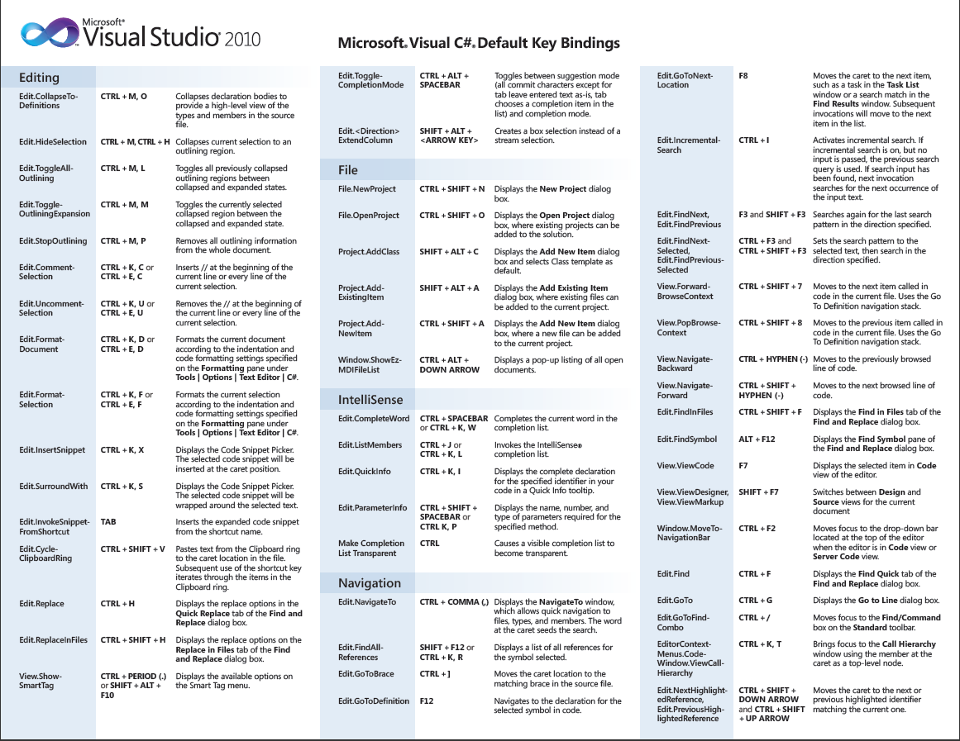

Slide 6
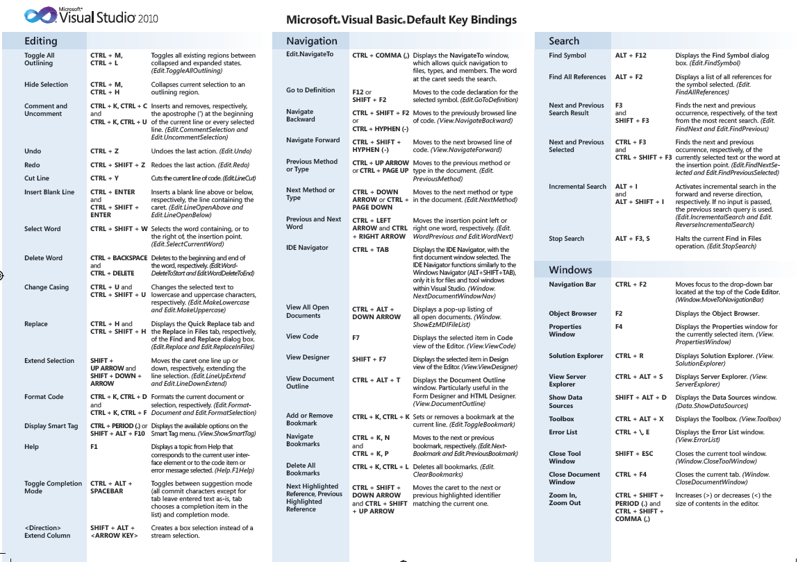

Slide 7
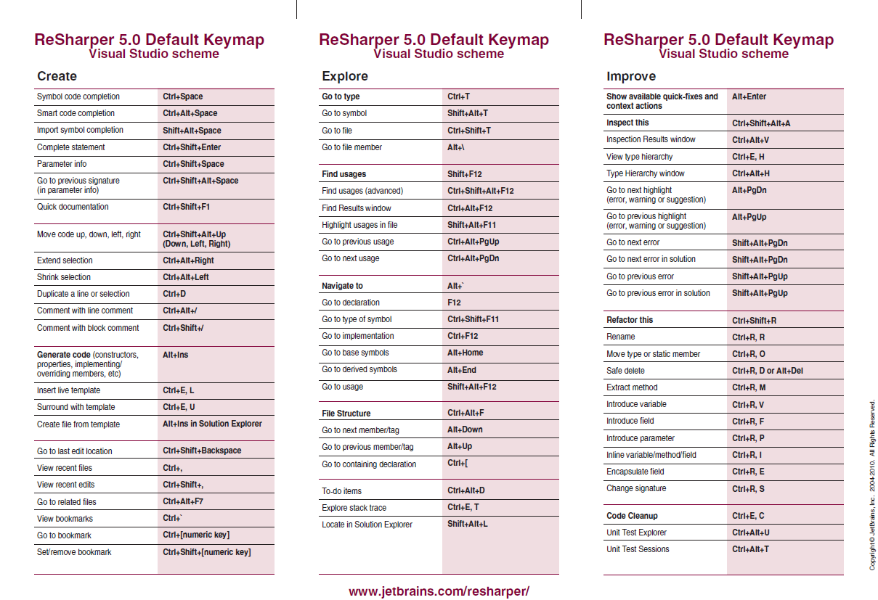

Slide 8
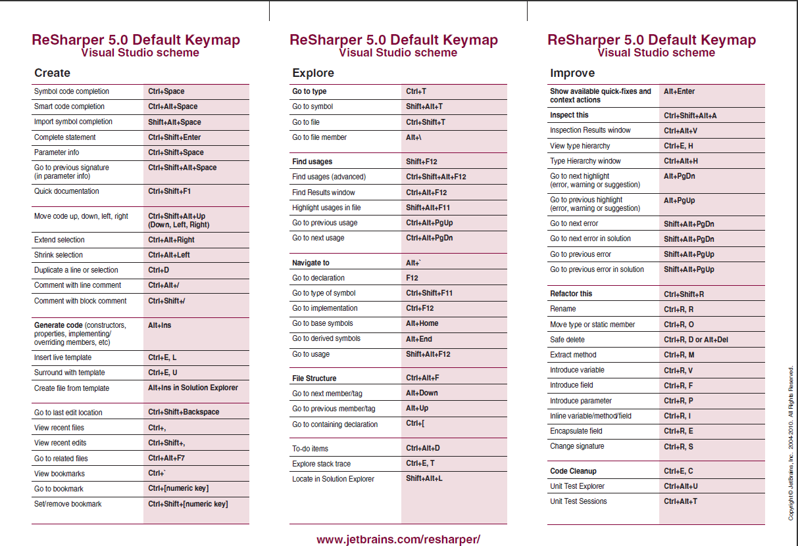

Slide 9
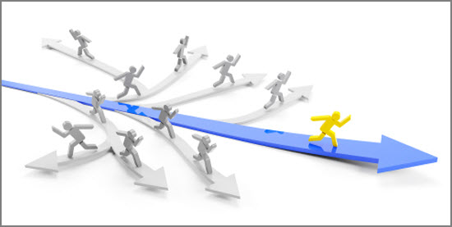

Slide 10


Slide 11




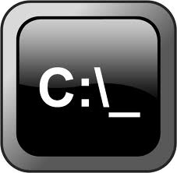



Slide 12
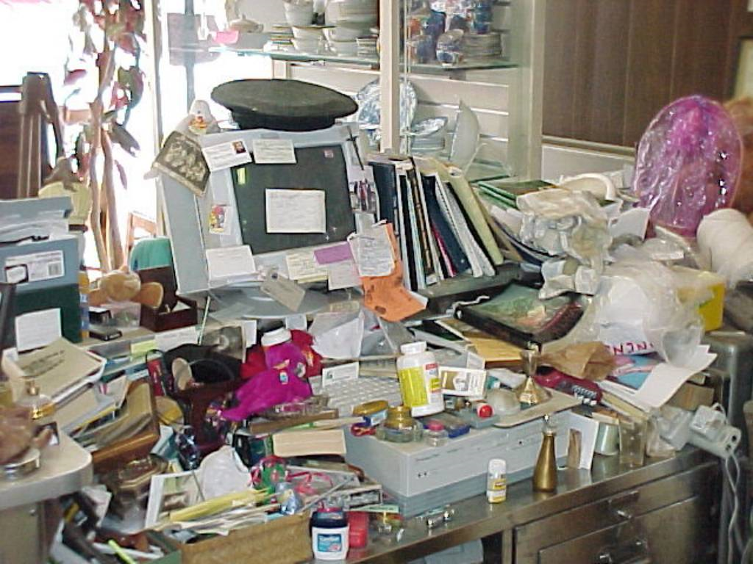
Notes:
Only keep out the documents are need for the task you are currently working on.

Slide 13
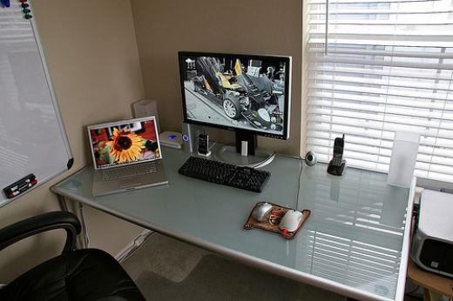

Slide 14
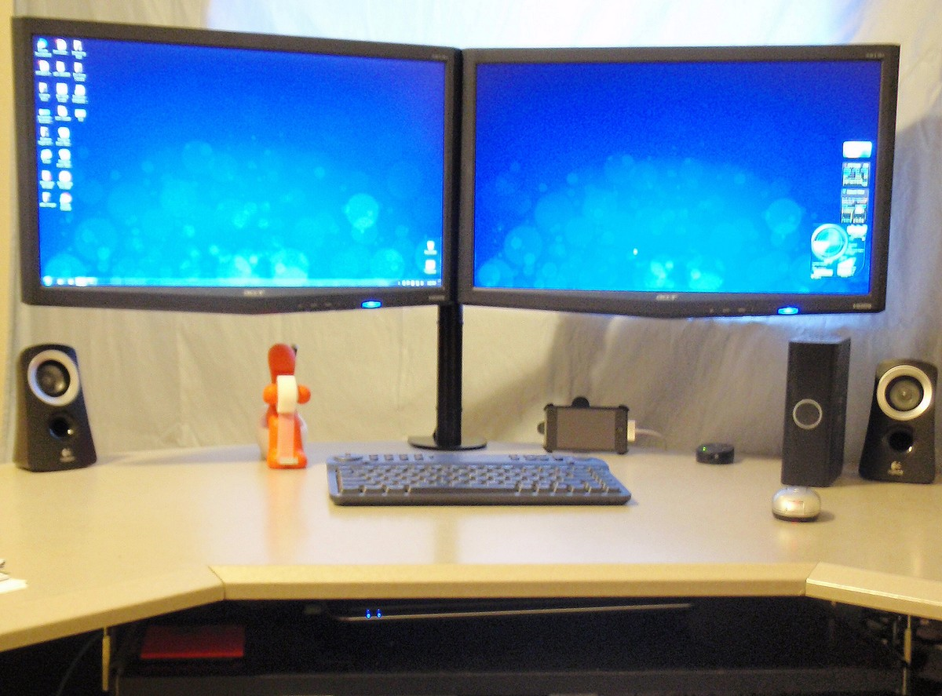

Slide 15
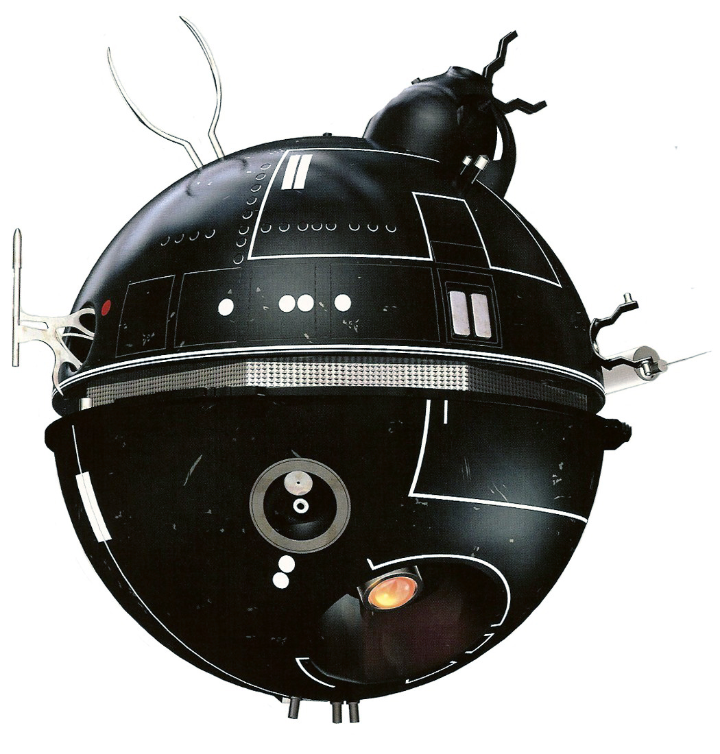
Notes:
Productivity Tools

Slide 16

Notes:
Set office hours

